Slide 1
Prof Narasanagi Oration – 2012 Hubli

Slide 2
Prof Narasanagi
Native of Bijapur Dt.
PG from Mumbai – 1962
Settled in Gulbarga
Rose to be HOD of Surgery
Director of BLDEA’s Medical College

Slide 3
Prof Narasanagi - Huge Achievements
Founder fellow of ASI
First from Karnataka to be President of ASI – 1993
President of ICS
Member of Editorial Board of ICS
Honourary Fellowship of RCS – Edinburgh
Rajyothsava Awardee

Slide 4
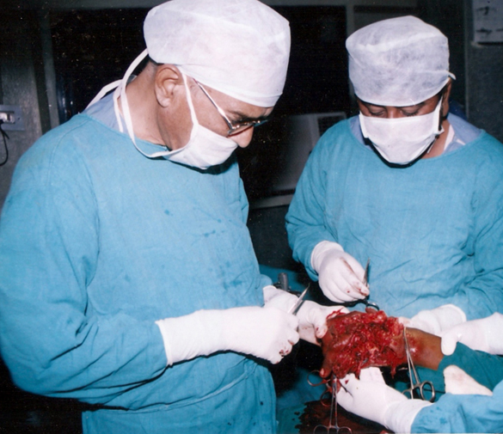
Prof Narasanagi - Huge Achievemnts
Teacher par excellence
Philanthropist
Scientist

Slide 5
Prof Narasanagi - Publications
Osteomyelitis in rural India.
Narasanagi SS.
Prog Pediatr Surg. 1982;15:203-8.
Rectal prolapse in children.
Narasanagi SS.
J Indian Med Assoc. 1974 Jun 1;62(11):378-80.
Compression of lateral cutaneous nerve of forearm.
Narasanagi SS.
Neurol India. 1972 Dec;20(4):224-5.

Slide 6
Prof Narasanagi
Practice EBS
Publish

